Slide 1

Recurrent Neural Networks
Why sequence models?
deeplearning.ai

Slide 2
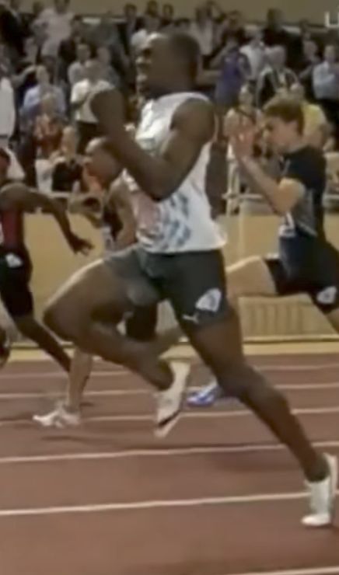
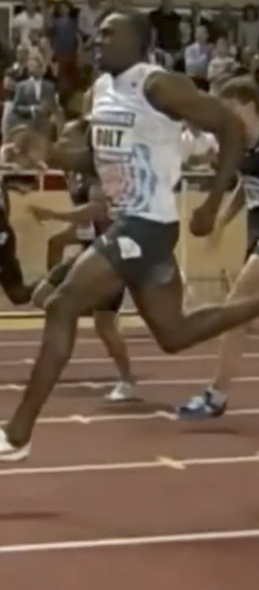
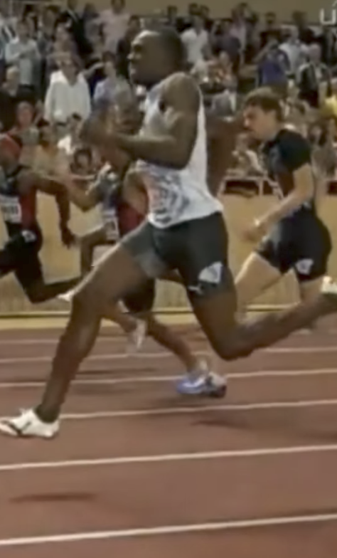
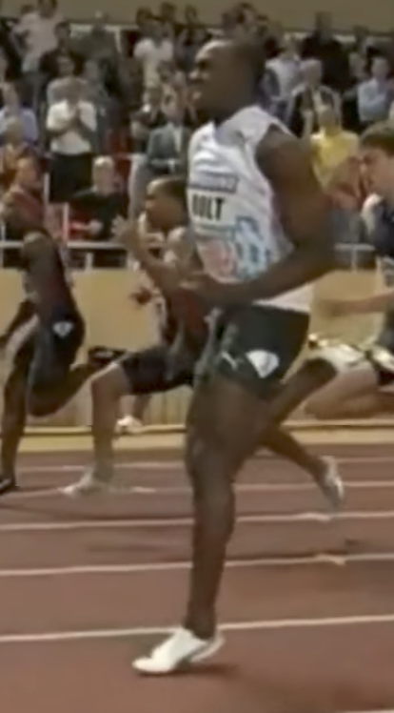
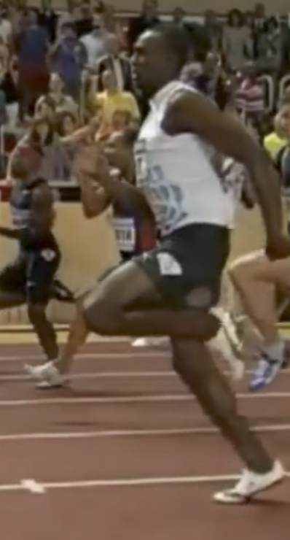

Examples of sequence data
“The quick brown fox jumped over the lazy dog.”
Speech recognition
Music generation
$$∅$$
Sentiment classification
“There is nothing to like in this movie.”
DNA sequence analysis
AGCCCCTGTGAGGAACTAG
AGCCCCTGTGAGGAACTAG
Machine translation
Voulez-vous chanter avec moi?
Do you want to sing with me?
Plasmid sequence AP4 Oligo
Video activity recognition
Running
Name entity recognition
Yesterday, Harry Potter met Hermione Granger.
Yesterday, Harry Potter met Hermione Granger.

Slide 3
Recurrent Neural Networks
Notation
deeplearning.ai

Slide 4
Motivating example
x:
Harry Potter and Hermione Granger invented a new spell.

Slide 5
Representing words
x:
Harry Potter and Hermione Granger invented a new spell.
$$x^{<1>}$$
$$x^{<2>}$$
$$x^{<3>}$$
$$⋯$$
$$x^{<9>}$$

Slide 6
Representing words
x:
Harry Potter and Hermione Granger invented a new spell.
$$x^{<1>}$$
$$x^{<2>}$$
$$x^{<3>}$$
$$⋯$$
$$x^{<9>}$$
And = 367
Invented = 4700
A = 1
New = 5976
Spell = 8376
Harry = 4075
Potter = 6830
Hermione = 4200
Gran… = 4000

Slide 7
Recurrent Neural Networks
Recurrent Neural Network Model
deeplearning.ai

Slide 8
Why not a standard network?
$$x^{<1>}$$
$$y^{<1>}$$
$$x^{<2>}$$
$$y^{<2>}$$
$$⋮$$
$$⋮$$
$$⋮$$
$$⋮$$
$$x^{<T_{x}>}$$
$$y^{<T_{y}>}$$
Problems:
- Inputs, outputs can be different lengths in different examples.
- Doesn’t share features learned across different positions of text.

Slide 9
Recurrent Neural Networks
He said, “Teddy Roosevelt was a great President.”
He said, “Teddy bears are on sale!”

Slide 10
Forward Propagation
$${\hat{y}}^{<1>}$$
$${\hat{y}}^{<2>}$$
$${\hat{y}}^{<3>}$$
$${\hat{y}}^{<T_{y}>}$$
$$a^{<1>}$$
$$a^{<2>}$$
$$a^{<T_{x}−1>}$$
$$a^{<0>}$$
$$⋯$$
$$x^{<1>}$$
$$x^{<2>}$$
$$x^{<3>}$$
$$x^{<T_{x}>}$$

Slide 11
Simplified RNN notation
$$a^{<t>}=g(W_{aa}a^{<t−1>}+W_{ax}x^{<t>}+b_{a})$$
$${\hat{y}}^{<t>}=g(W_{ya}a^{<t>}+b_{y})$$

Slide 12
Recurrent Neural Networks
Backpropagation through time
deeplearning.ai

Slide 13
Forward propagation and backpropagation
$${\hat{y}}^{<1>}$$
$${\hat{y}}^{<2>}$$
$${\hat{y}}^{<3>}$$
$${\hat{y}}^{<T_{y}>}$$
$$a^{<1>}$$
$$a^{<2>}$$
$$a^{<T_{x}−1>}$$
$$a^{<0>}$$
$$⋯$$
$$x^{<1>}$$
$$x^{<2>}$$
$$x^{<3>}$$
$$x^{<T_{x}>}$$

Slide 14
Forward propagation and backpropagation
$$ℒ^{<t>}\left({\hat{y}}^{<t>},y^{<t>}\right)=$$
Backpropagation through time

Slide 15
Recurrent Neural Networks
Different types
of RNNs
deeplearning.ai

Slide 16
Examples of sequence data
“The quick brown fox jumped over the lazy dog.”
Speech recognition
Music generation
$$∅$$
Sentiment classification
“There is nothing to like in this movie.”
DNA sequence analysis
AGCCCCTGTGAGGAACTAG
AGCCCCTGTGAGGAACTAG
Machine translation
Voulez-vous chanter avec moi?
Do you want to sing with me?
Plasmid sequence AP4 Oligo
Video activity recognition
Running
Name entity recognition
Yesterday, Harry Potter met Hermione Granger.
Yesterday, Harry Potter met Hermione Granger.

Slide 17
Examples of RNN architectures

Slide 18
Examples of RNN architectures

Slide 19
Summary of RNN types
$${\hat{y}}^{<1>}$$
$${\hat{y}}^{<1>}$$
$${\hat{y}}^{<2>}$$
$${\hat{y}}^{<T_{y}>}$$
$${\hat{y}}^{ }$$
$$a^{<0>}$$
$$a^{<0>}$$
$$⋯$$
$$a^{<0>}$$
$$⋯$$
$$x^{<1>}$$
$$x$$
$$x^{<1>}$$
$$x^{<2>}$$
$$x^{<T_{x}>}$$
One to one
One to many
Many to one
$${\hat{y}}^{<1> }$$
$${\hat{y}}^{<2> }$$
$${{\hat{y}}^{<1>}}^{ }$$
$${{\hat{y}}^{<T_{y}>}}^{ }$$
$${\hat{y}}^{<T_{y}> }$$
$$a^{<0>}$$
$$⋯$$
$$⋯$$
$$⋯$$
$$a^{<0>}$$
$$⋯$$
$$x^{<1>}$$
$$x^{<T_{x}>}$$
$$x^{<1>}$$
$$x^{<2>}$$
$$x^{<T_{x}>}$$
Many to many
Many to many

Slide 20
Recurrent Neural Networks
Language model and sequence generation
deeplearning.ai

Slide 21
What is language modelling?
Speech recognition
The apple and pair salad.
The apple and pear salad.
$P($The apple and pair salad$)=$
$P($The apple and pear salad$)=$

Slide 22
Language modelling with an RNN
Training set: large corpus of english text.
Cats average 15 hours of sleep a day.
The Egyptian Mau is a bread of cat. <EOS>

Slide 23
RNN model
Cats average 15 hours of sleep a day. <EOS>
$$ℒ\left({\hat{y}}^{<t>},y^{<t>}\right)=−\sum_{i}{ }y_{i}^{<t>}{\log{\hat{y}}}_{i}^{<t>}$$
$$ℒ^{ }=\sum_{t}{ }ℒ^{<t>}\left({\hat{y}}^{<t>},y^{<t>}\right)$$

Slide 24
Recurrent Neural Networks
Sampling novel sequences
deeplearning.ai

Slide 25
Sampling a sequence from a trained RNN
$${\hat{y}}^{<1> }$$
$${\hat{y}}^{<2> }$$
$${\hat{y}}^{<3> }$$
$${\hat{y}}^{<T_{y}> }$$
$$a^{<0>}$$
$$a^{<1>}$$
$$a^{<2>}$$
$$a^{<3>}$$
$$⋯$$
$$a^{<T_{y}>}$$
$$x^{<1>}$$
$$y^{<1>}$$
$$y^{<2>}$$
$$y^{<T_{x}−1>}$$

Slide 26
Character-level language model
Vocabulary = [a, aaron, …, zulu, <UNK>]
$${\hat{y}}^{<1> }$$
$${\hat{y}}^{<2> }$$
$${\hat{y}}^{<3> }$$
$${\hat{y}}^{<T_{y}> }$$
$$a^{<0>}$$
$$a^{<1>}$$
$$a^{<2>}$$
$$a^{<3>}$$
$$⋯$$
$$a^{<T_{y}>}$$
$$x^{<1>}$$
$${\hat{y}}^{<1> }$$
$${\hat{y}}^{<2> }$$
$${\hat{y}}^{<T_{x}−1> }$$

Slide 27
Sequence generation
News
Shakespeare
President enrique peña nieto, announced sench’s sulk former coming football langston paring.
“I was not at all surprised,” said hich langston.
“Concussion epidemic”, to be examined.
The gray football the told some and this has on the uefa icon, should money as.
The mortal moon hath her eclipse in love.
And subject of this thou art another this fold.
When besser be my love to me see sabl’s.
For whose are ruse of mine eyes heaves.

Slide 28
Recurrent Neural Networks
Vanishing gradients with RNNs
deeplearning.ai

Slide 29
Vanishing gradients with RNNs
$${\hat{y}}^{<1> }$$
$${\hat{y}}^{<2> }$$
$${\hat{y}}^{<3> }$$
$${\hat{y}}^{<T_{y}> }$$
$$a^{<0>}$$
$$a^{<1>}$$
$$a^{<2>}$$
$$a^{<3>}$$
$$⋯$$
$$a^{<T_{y}>}$$
$$x^{<1>}$$
$$x^{<2>}$$
$$x^{<3>}$$
$$x^{<T_{x}>}$$
$$x^{ }$$
$$⋯$$
$${\hat{y}}^{ }$$
$$⋮$$
$$⋮$$
$$⋮$$
$$⋮$$
$$⋮$$
$$⋮$$
$$⋮$$
Exploding gradients.

Slide 30
Recurrent Neural Networks
Gated Recurrent Unit (GRU)
deeplearning.ai

Slide 31
RNN unit
$$a^{<t>}=g(W_{a}\left[a^{<t−1>}, x^{<t>}\right]+b_{a})$$
$${\hat{y}}^{<1> }$$
$$a^{<0>}$$
$$a^{<1>}$$
$$x^{<1>}$$

Slide 32
GRU (simplified)
The cat, which already ate …, was full.
[Cho et al., 2014. On the properties of neural machine translation: Encoder-decoder approaches]
[Chung et al., 2014. Empirical Evaluation of Gated Recurrent Neural Networks on Sequence Modeling]

Slide 33
Full GRU
$${\tilde{c}}^{<t>}=\tanh{(W_{c}[}$$
$$c^{<t−1>},x^{<t>}]+b_{c})$$
$$Γ_{u}=σ{(W_{u}\left[ c^{<t−1>},x^{<t>}\right]+b_{u})}$$
$$c^{<t>}=Γ_{u}{∗{\tilde{c}}^{<t>}+\left(1−Γ_{u}\right)+c^{<t−1>}}$$
The cat, which ate already, was full.

Slide 34
Recurrent Neural Networks
LSTM (long short term memory) unit
deeplearning.ai

Slide 35
GRU and LSTM
GRU
LSTM
$${\tilde{c}}^{<t>}=\tanh{(W_{c}\left[Γ_{r}∗c^{<t−1>},x^{<t>}\right]+b_{c})}$$
$$Γ_{u}=σ{(W_{u}\left[ c^{<t−1>},x^{<t>}\right]+b_{u})}$$
$$Γ_{r}=σ{(W_{r}\left[ c^{<t−1>},x^{<t>}\right]+b_{r})}$$
$$c^{<t>}=Γ_{u}{∗{\tilde{c}}^{<t>}+\left(1−Γ_{u}\right)∗c^{<t−1>}}$$
$$a^{<t>}=c^{<t>}$$
[Hochreiter & Schmidhuber 1997. Long short-term memory]

Slide 36
LSTM units
GRU
LSTM
$${\tilde{c}}^{<t>}=\tanh{(W_{c}\left[Γ_{r}∗c^{<t−1>},x^{<t>}\right]+b_{c})}$$
$${\tilde{c}}^{<t>}=\tanh{(W_{c}\left[a^{<t−1>},x^{<t>}\right]+b_{c})}$$
$$Γ_{u}=σ{(W_{u}\left[ c^{<t−1>},x^{<t>}\right]+b_{u})}$$
$$Γ_{u}=σ{(W_{u}\left[ a^{<t−1>},x^{<t>}\right]+b_{u})}$$
$$Γ_{r}=σ{(W_{r}\left[ c^{<t−1>},x^{<t>}\right]+b_{r})}$$
$$Γ_{f}=σ{(W_{f}\left[ a^{<t−1>},x^{<t>}\right]+b_{f})}$$
$$c^{<t>}=Γ_{u}{∗{\tilde{c}}^{<t>}+\left(1−Γ_{u}\right)∗c^{<t−1>}}$$
$$Γ_{o}=σ{(W_{o}\left[ a^{<t−1>},x^{<t>}\right]+b_{o})}$$
$$a^{<t>}=c^{<t>}$$
$$c^{<t>}={Γ_{u}∗{\tilde{c}}^{<t>}+Γ_{f}∗c^{<t−1>}}$$
$$a^{<t>}=Γ_{o}∗c^{<t>}$$
[Hochreiter & Schmidhuber 1997. Long short-term memory]

Slide 37
LSTM in pictures
$$y^{<t>}$$
$${\tilde{c}}^{<t>}=\tanh{(W_{c}\left[a^{<t−1>},x^{<t>}\right]+b_{c})}$$
softmax
$$a^{<t>}$$
$$Γ_{u}=σ{(W_{u}\left[ a^{<t−1>},x^{<t>}\right]+b_{u})}$$
-
-
$$c^{<t−1>}$$
$$c^{<t>}$$
-
*
$$⨁$$
-
$$Γ_{f}=σ{(W_{f}\left[ a^{<t−1>},x^{<t>}\right]+b_{f})}$$
$$c^{<t>}$$
*
tanh
$$Γ_{o}=σ{(W_{o}\left[ a^{<t−1>},x^{<t>}\right]+b_{o})}$$
$$a^{<t−1>}$$
*
$$a^{<t>}$$
$$f^{<t>}$$
$$i^{<t>}$$
$${\tilde{c}}^{<t>}$$
$$o^{<t>}$$
$$a^{<t>}$$
$$c^{<t>}={Γ_{u}∗{\tilde{c}}^{<t>}+Γ_{f}∗c^{<t−1>}}$$
forget gate
update gate
tanh
output gate
$$a^{<t>}=Γ_{o}∗c^{<t>}$$
$$x^{<t>}$$
$$y^{<1>}$$
$$y^{<2>}$$
$$y^{<3>}$$
softmax
softmax
softmax
$$a^{<1>}$$
$$a^{<2>}$$
-
$$c^{<2>}$$
$$a^{<3>}$$
-
-
$$c^{<1>}$$
-
-
$$c^{<3>}$$
-
-
-
-
-
-
$$c^{<0>}$$
*
$$⨁$$
-
$$c^{<1>}$$
*
$$⨁$$
$$c^{<2>}$$
*
$$⨁$$
$$a^{<0>}$$
$$a^{<1>}$$
$$a^{<2>}$$
$$a^{<2>}$$
$$a^{<1>}$$
$$a^{<3>}$$
$$x^{<1>}$$
$$x^{<2>}$$
$$x^{<3>}$$

Slide 38
Recurrent Neural Networks
Bidirectional RNN
deeplearning.ai

Slide 39
Getting information from the future
He said, “Teddy bears are on sale!”
He said, “Teddy Roosevelt was a great President!”
$${\hat{y}}^{<1> }$$
$${\hat{y}}^{<2> }$$
$${\hat{y}}^{<3> }$$
$${\hat{y}}^{<4> }$$
$${\hat{y}}^{<5> }$$
$${\hat{y}}^{<6> }$$
$${\hat{y}}^{<7> }$$
$$a^{<0>}$$
$$a^{<1>}$$
$$a^{<2>}$$
$$a^{<3>}$$
$$a^{<4>}$$
$$a^{<5>}$$
$$a^{<6>}$$
$$a^{<7>}$$
$$x^{<1>}$$
$$x^{<2>}$$
$$x^{<3>}$$
$$x^{<4>}$$
$$x^{<5>}$$
$$x^{<6>}$$
$$x^{<7>}$$
He said, “Teddy bears are on sale!”

Slide 40
Bidirectional RNN (BRNN)

Slide 41
Recurrent Neural Networks
Deep RNNs
deeplearning.ai

Slide 42
Deep RNN example
$$y^{<1>}$$
$$y^{<2>}$$
$$y^{<3>}$$
$$y^{<4>}$$
$$a^{[3]<0>}$$
$$a^{[3]<1>}$$
$$a^{[3]<2>}$$
$$a^{[3]<3>}$$
$$a^{[3]<4>}$$
$$a^{[2]<0>}$$
$$a^{[2]<1>}$$
$$a^{[2]<2>}$$
$$a^{[2]<3>}$$
$$a^{[2]<4>}$$
$$a^{[1]<0>}$$
$$x^{<1>}$$
$$x^{<2>}$$
$$x^{<3>}$$
$$x^{<4>}$$

